Slide 1

Homeservice WUW : What-U-Want
Designed and Developed by : Asiah Farooq Khalidi
Anam Fatima
Mariyam Zehra

Slide 2
Presentation Outline:
About Project
Requirements
Technology Used
Project Progress Plan Including 7 phases of software development
Role of members individually

Slide 3
About Project :
WUW – “What U Want” is an online platform that provide trained worker at your home.
It provides Electrician, plumber, Ac Electrician, Driver, Tutor, Guard and many more at your home in low rate.
It always wants to see the benefit of their customer and provide good quality of service by our trained workers.
It makes sure of giving more importance to the need and requirements of the customer.

Slide 4
Requirements:
Hardware and Software Requirements
Hardware Specification
Android Device
8GB RAM
Software Specification
Android Studio
Firebase
Android virtual Machine

Slide 5
Technology Used:
Front End
XML
Back End
Firebase
Java

Slide 6
XML:
XML stands for Extensible Markup Language.
XML is Extensible.
XML focuses on data rather than how it looks.
XML is a public standard.

Slide 7
Firebase:
Used for mobile app development and web development.
Stores data and also works as a server.
The main goal of the system is to provide a secure, reliable and fast way to synchronize data with a minimal amount of coding effort on the part of the developer.
The purpose of the Realtime Database feature of Firebase is to allow data to be shared between multiple clients.

Slide 8
Java:
Java is platform-independent.
It is used for developing Android Apps.
It is a computing platform for application development
It is fast, secure, and reliable.
Java Platform is a collection of programs that help programmers to develop and run Java programming applications efficiently.

Slide 9
Project Progress Plan:
First three phases of software development i.e.:
Planning
Requirement Analysis
Design
has been completed till now.
Next phases which are yet to be completed are:
Development
Testing
Implementation
Maintenance

Slide 10
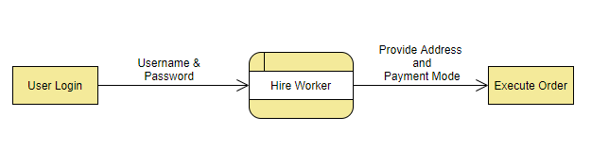
Project Progress Plan(contd.):
Design Phase:
Level 0 DFD:

Slide 11
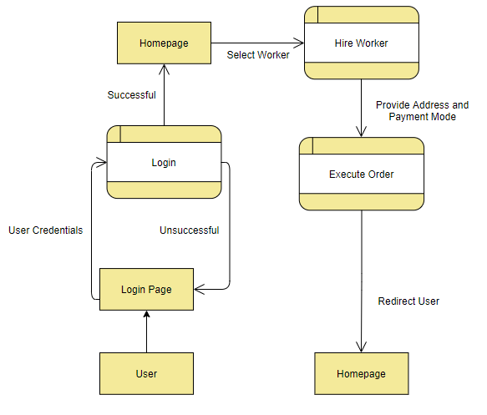
Project Progress Plan(contd.):
Design Phase:
Level 1 DFD:

Slide 12
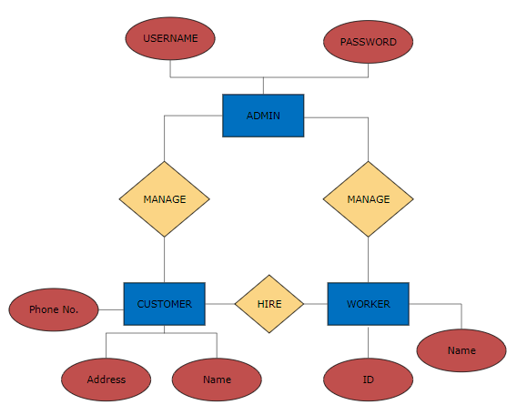
Project Progress Plan(contd.):
Design Phase:
ER Diagram:

Slide 13
Role of members individually:
Planning: Mariyam Zehra
Requirement Analysis: Anam Fatima
Design Analysis: Asiah Farooq Khalidi
We have done each and every work in coordination.
We have helped each other in every way.

Slide 14
Thankyou!

